Slide 1
Categories of Optics

Slide 2
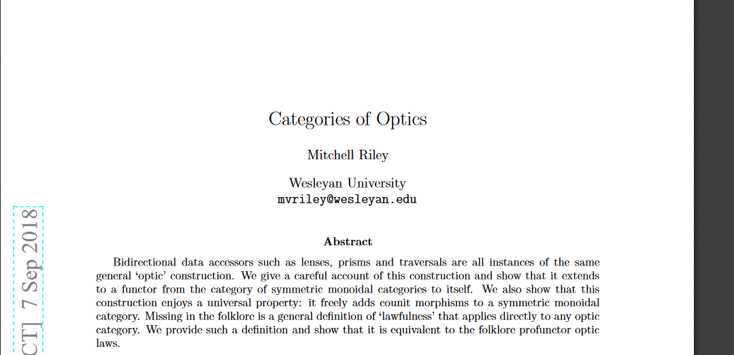
Taken From

Slide 3


Usual Lenses
data PolymorphicLens s1 s2 a1 a2 = PolymorphicLens{
get :: s1-> a1,
put :: s1->a2->s2
}
Composition is given by something like below:
This is the composition for Monomorphic case: (Lenses s s a a) and (Lenses t t s s)

Slide 4

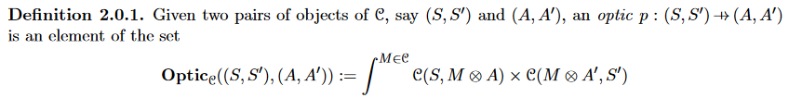
General Symmetric Monoidal Category
Assume target category has all colimits so can write the coend as
forall m. Lens {
l :: s -> (m,a)
R :: (m,a’) -> s’
}
Subject to an equivalence relation

Slide 5
Sum Examples
Suppose the monoidal structure is Either
Coend over the product
C(s1, Either m a1) , C ( Either m a2 , s2)
C(a2,s2) factors out and remaining coend over C(s1,Either m a) , C ( m , s2)
data PolymorphicPrism s1 s2 a1 a2 = PolymorphicPrism{
review :: a2 -> s2,
matching :: s1 -> Either s2 a1

Slide 6
Some more special cases
Adapters have put that don’t depend on their s1 first argument
from_function_pair :: (s1 -> a1) -> (a2 -> s2) -> Adapter s1 s2 a1 a2
from_function_pair f g = Adapter{get_a=f,put_a=g}
This provides a functor C \times C^{op} \to Optics_C
type Costate s1 s2 = PolymorphicLens s1 s2 Singleton Singleton
type Connector s = Costate s s
type State a1 a2 = PolymorphicLens Singleton Singleton a1 a2

Slide 7
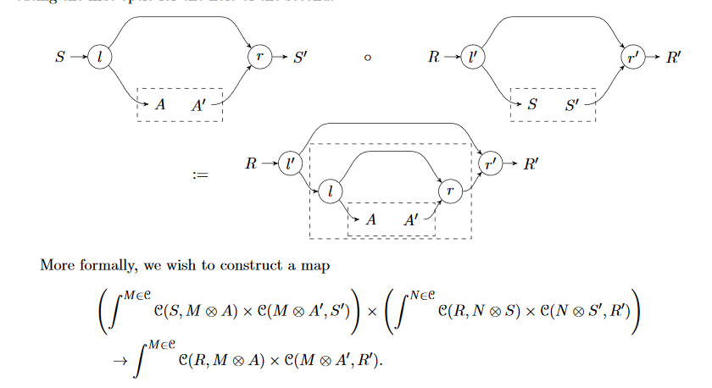
Those were morphisms of category

Slide 8
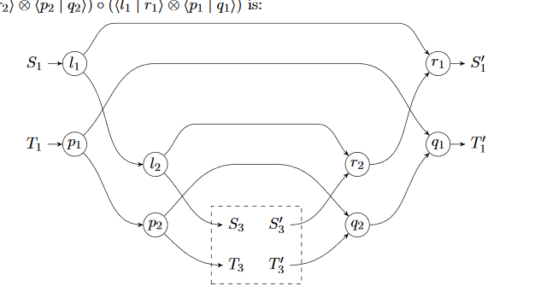
… a symmetric monoidal category

Slide 9
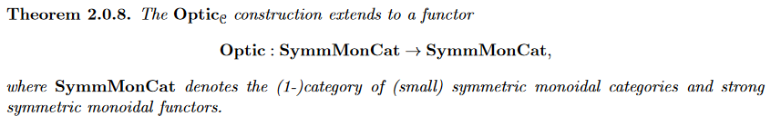
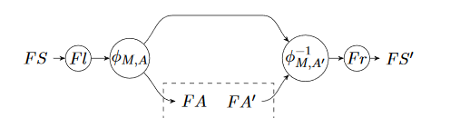
Optics in C vs Optics in D
(FS,FS’) on objects
The following on morphisms

Slide 10
Applicative
Applicative enough for for some parts
optic_C_to_D :: (Applicative f) => PolymorphicLens s1 s2 a1 a2 -> PolymorphicLens (f s1) (f s2) (f a1) (f a2)
optic_C_to_D lens_c = PolymorphicLens{get = fmap (get lens_c),put = modified_star (fmap (\x->(put lens_c x)))}
C and D are both Hask in this case: endofunctor

Slide 11
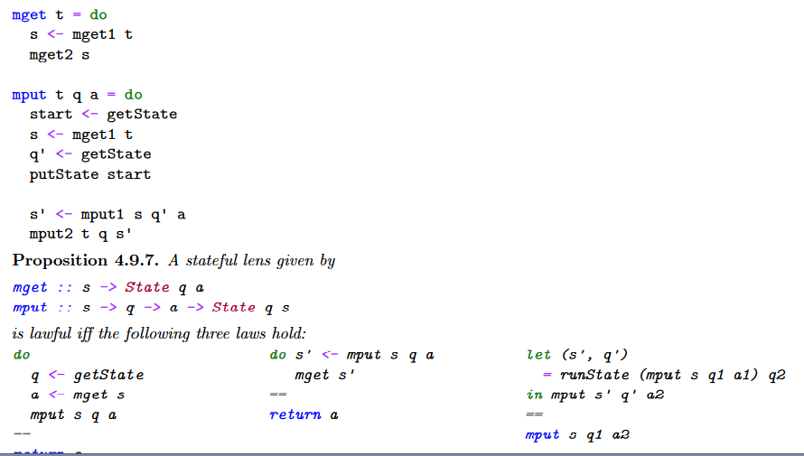
That was just the beginning

Slide 12
The idea there is to use module categories for a symmetric monoidal category instead of just a single symmetric monoidal category C
Can then make constructions that use Kleisli category for some monads

